Slide 1

Heart Disease Data Analysis Report
Understanding Factors and Building Predictive Models
Exploring patient health metrics
Turning data into actionable insights
Notes:
This slide serves as the introductory point of the presentation. It highlights the main focus of the analysis, which is to understand the factors contributing to heart disease and to develop predictive models based on patient health metrics. The aim is to convert data into meaningful insights that can help in making informed health decisions.

Slide 2
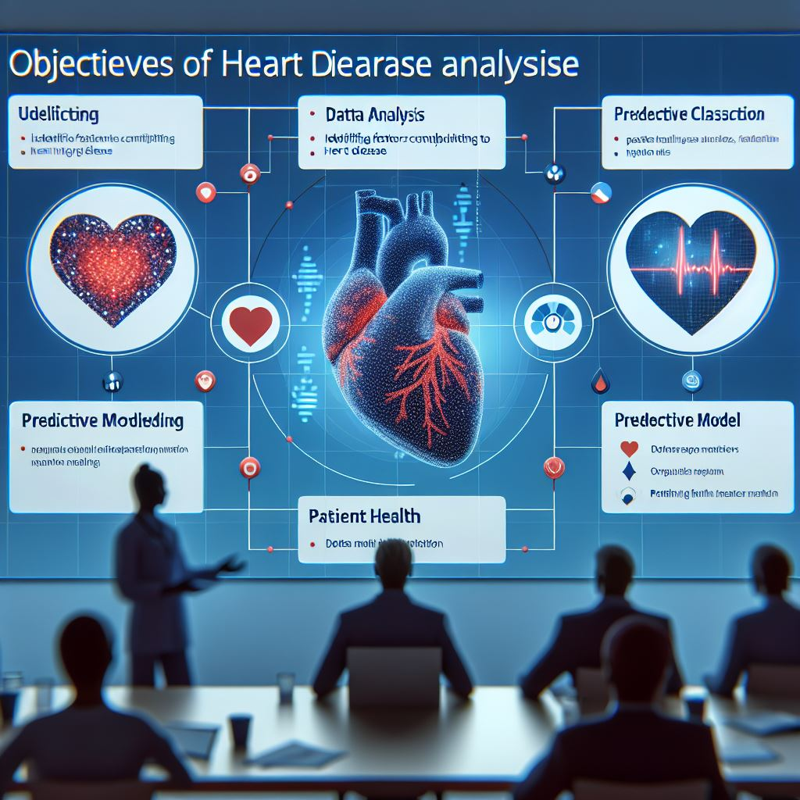
Heart Disease Data Analysis Report
Understanding health metrics and predictive modeling.
Focus on heart disease factors and outcomes.
Data-driven insights for better health decisions.
Notes:
This title slide introduces the Heart Disease Data Analysis Report. It sets the stage for discussing key factors affecting heart disease and highlights the importance of building predictive models to understand these factors better.

Slide 3

Objectives of the Analysis
Identify factors contributing to heart disease.
Build an effective predictive classification model.
Utilize patient health data for insights.
Notes:
The objective of this analysis is to understand the underlying factors that contribute to heart disease and to develop a predictive model that can classify patients based on health metrics.

Slide 4

Overview of the Dataset
Key features include age, sex, and cholesterol.
Target variable indicates heart disease presence.
A total of 13 features collected.
Notes:
The dataset comprises various patient health metrics including age, sex, and cholesterol levels, alongside a target variable that indicates the presence of heart disease. A total of 13 features are analyzed.

Slide 5
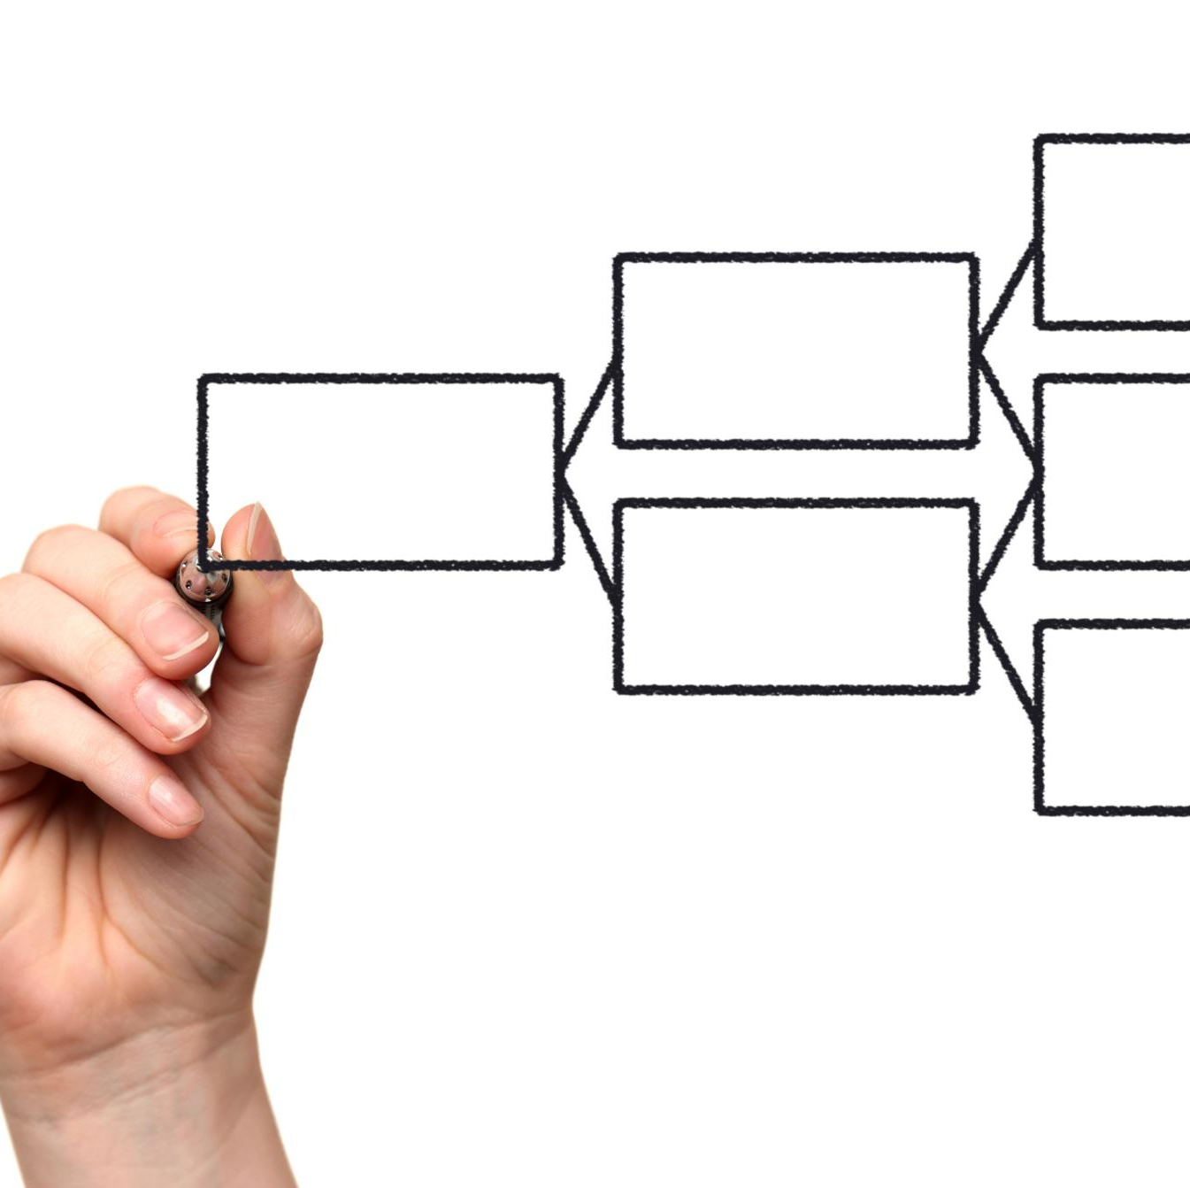
Analysis Methodology
Preprocessing to handle missing data.
Explore relationships through EDA.
Model selection including Logistic Regression.
Notes:
Our methodology involves preprocessing the data to handle missing values, conducting exploratory data analysis to visualize relationships, and selecting appropriate models such as Logistic Regression and Random Forest.

Slide 6

Exploratory Data Analysis Insights
Identify relationships and correlations.
Visualize distributions of health metrics.
Assess feature importance for prediction.
Notes:
Through exploratory data analysis, we identify crucial relationships between health metrics and heart disease presence. Visualizations like scatter plots and heatmaps help us assess feature importance.

Slide 7

Evaluation of Models
Logistic Regression provides baseline accuracy.
Random Forest captures non-linear relationships.
SVM shows competitive performance.
Notes:
We evaluate several models, including Logistic Regression for baseline accuracy, Random Forest for its ability to capture complex relationships, and SVM for its robust classification performance.

Slide 8
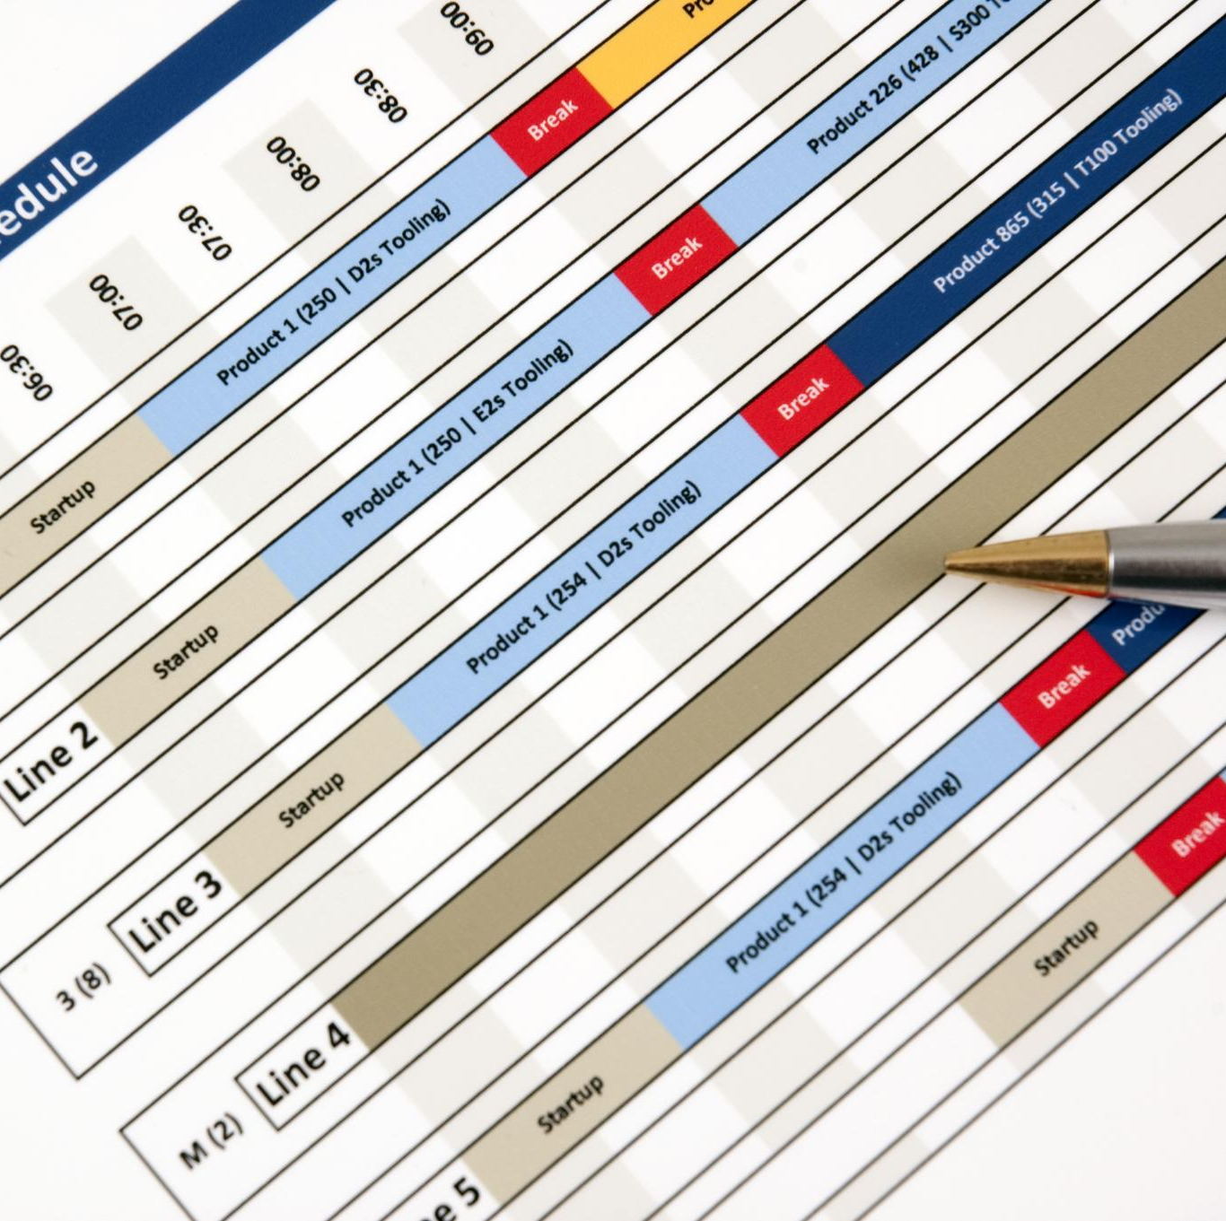
Key Findings from the Analysis
Random Forest outperforms other models.
Cholesterol levels are significant predictors.
Feature importance highlights critical factors.
Notes:
The analysis reveals that Random Forest provides the best performance, identifying key predictors such as cholesterol levels and chest pain type as significant factors contributing to heart disease.

Slide 9
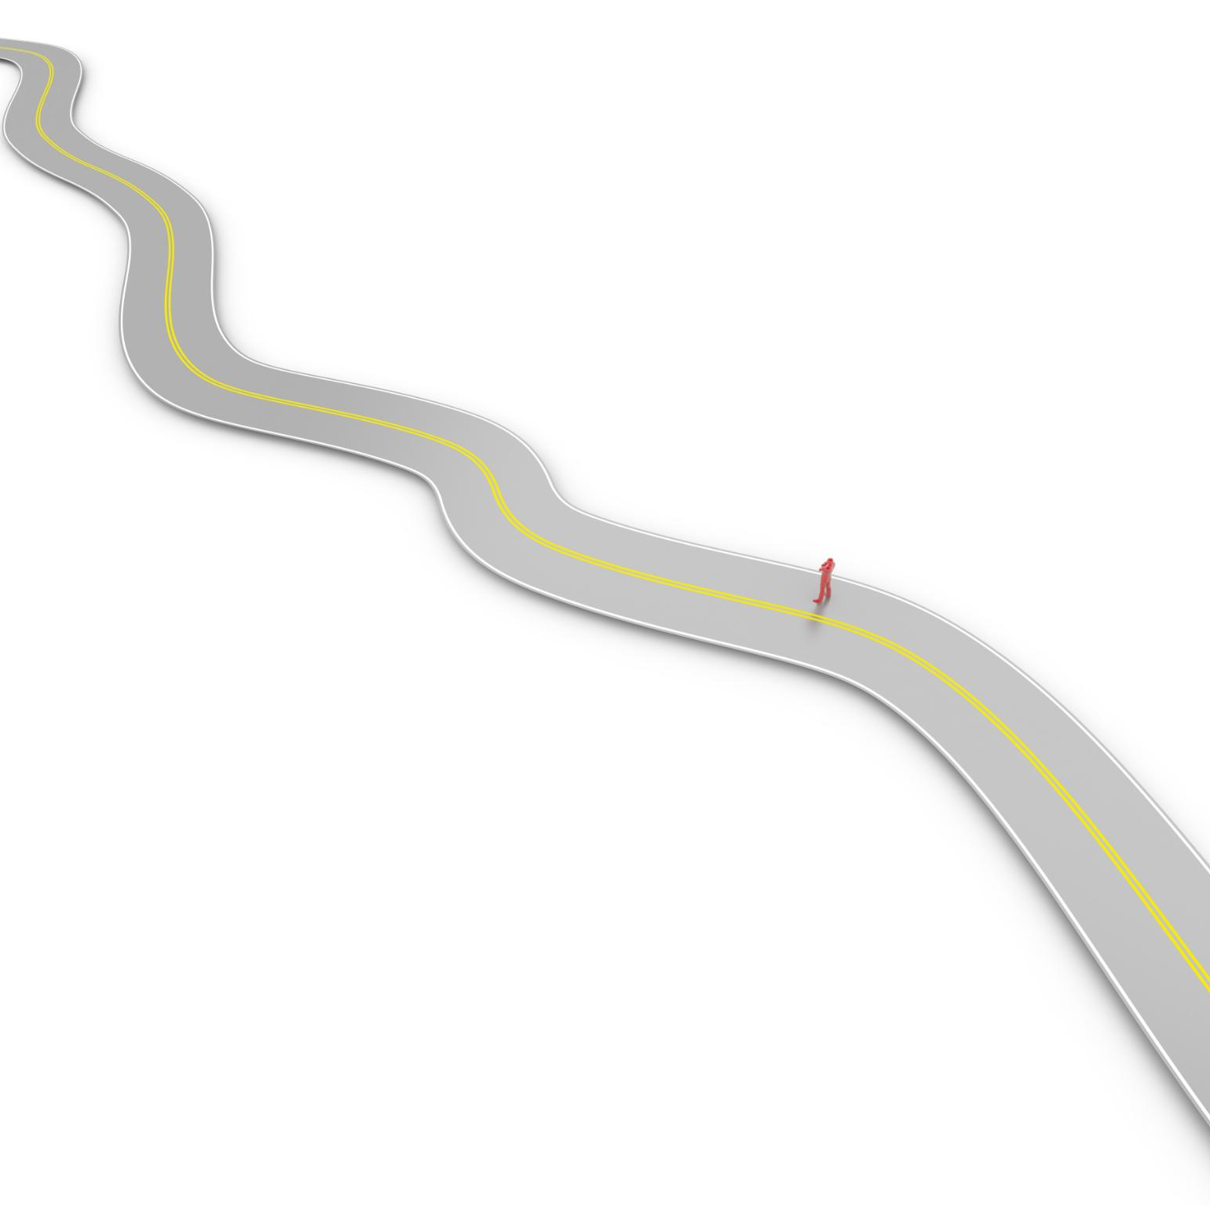
Conclusion and Achievements
Identified key factors associated with heart disease.
Developed a predictive model demonstrating effectiveness.
Future work includes exploring advanced models.
Notes:
In conclusion, we successfully identified key factors associated with heart disease and developed a predictive model that performs satisfactorily. Future directions include exploring advanced modeling techniques.

Slide 10

Recommendations for Future Work
Enhance feature engineering for better predictions.
Expand data collection for more robust models.
Implement model deployment in clinical settings.
Notes:
For future work, we recommend enhancing feature engineering techniques, expanding the dataset for robustness, and considering implementation of the predictive model in clinical environments for real-time predictions.

Slide 11

Q&A Session
Open floor for audience questions.
Encourage discussion about findings.
Invite feedback on analysis methodology.
Notes:
We now open the floor for any questions or discussions regarding the findings of our analysis. We welcome your insights and feedback on our methodology and results.

